Slide 1

uantum
Society
at Auburn

Slide 2
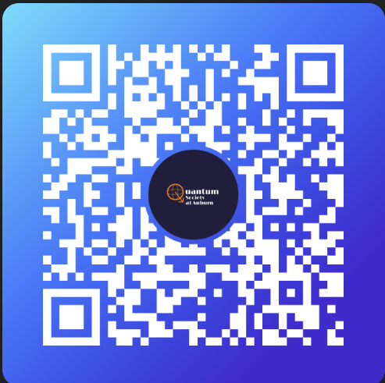
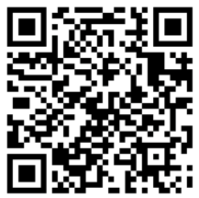
Join the GroupMe!
Fill out the interest form!

Slide 3


Shlok
Jack
President
Vice President
I’m a sophomore in computer engineering with minors in math and physics. For almost a year, I’ve been doing research in quantum algorithms and mathematical foundations of quantum information.
I'm a 2nd year PhD student in Mathematics studying Algebraic Geometry and Invariant Theory with applications to quantum and classical systems.
$$|01⟩$$

Slide 4


Intro to Quantum Programming
Workshops
Competitive Hackathon Team
Colloquiums
Speakers from industry and academia coming in to talk about their bleeding-edge research in quantum computing.
A dedicated team attending weekly* practices to prepare for, travel to, and compete in quantum hackathons from MIT to Oak Ridge.
A series of workshops that starts at basic linear algebra, vectors and matrices, and ends with your own circuit running on real QPUs. No prerequisites, or prior knowledge necessary.
$$|02⟩$$

Slide 5


INTRO TO QUANTUM PROGRAMMING WORKSHOPS
Foundations
Circuits
Algorithms
Projects
Gates
Measurements
Control Flow
Teleportation
Superdense-Coding
Error Correction
Variational Algorithms
Hadamard Test
Grover’s Algorithm
Shor’s Algorithm
Build out a real algorithm and project running on actual quantum hardware
Linear Algebra
Qubits
Dirac Notation Superposition Entanglement
$$|03⟩$$

Slide 6
Algorithms
Gates
Circuits
Qubits
Linear Algebra
Error
Correction
Entanglement
Measurement
Superposition

